Slide 1

AN END-TO-END TEACHING CURRICULUM
Zomato AI Data
Engineering Project
From raw CSVs to an AI-powered warehouse — a complete modern data stack, built on one food-delivery dataset.
S3
Snowflake
dbt
Airflow
Docker
OpenAI
Streamlit
Batch pipeline · Medallion architecture · LLM enrichment, RAG & text-to-SQL

Slide 2
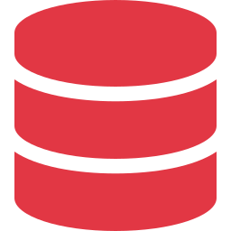

BEFORE WE START
Prerequisites — you need surprisingly little
Basic SQL
Basic Python
SELECT, GROUP BY, JOIN. If you can write a query with a filter and an aggregate, you're ready.
Run a script, read a function. No frameworks, no advanced patterns required.
Cross-cutting tools you'll pick up along the way:
SQL
Python
AWS S3 + IAM
Snowflake
dbt
Airflow
Docker
OpenAI API
Streamlit
Git

Slide 3
0
Introduction & Architecture

Slide 4


Slide 5
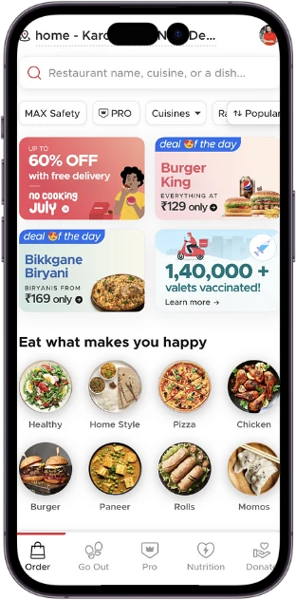

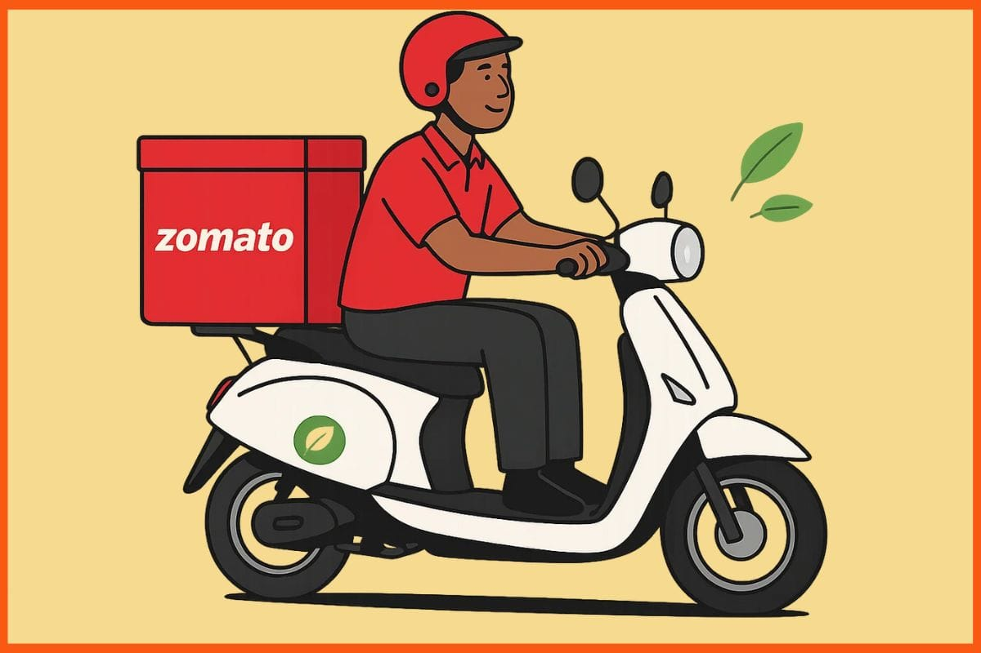



Slide 6
I NEED AI DATA PIPELINE

Slide 7
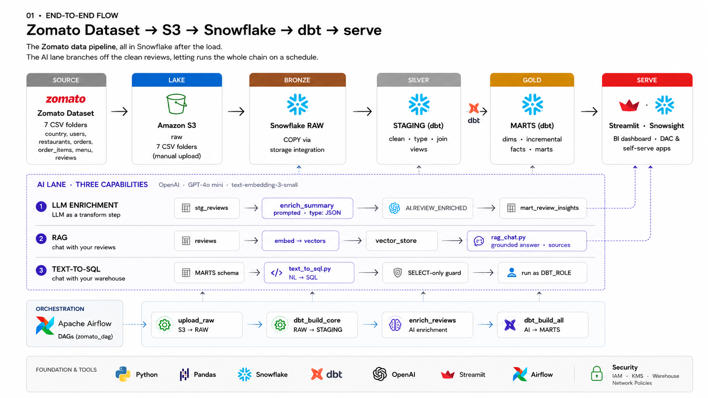

Slide 8






The dataset — a food-delivery business
Familiar domain, real analytical questions: growth, cancellations, delivery speed, customer sentiment.
users
restaurants
menu_items
Who orders — city, signup date
Who sells — cuisine, city, rating
What's sold — item, price, category
orders
order_items
reviews
The core fact — status, amounts, times
Line items — order × menu item × qty
Free-text comments + ratings (AI fuel)

Slide 9
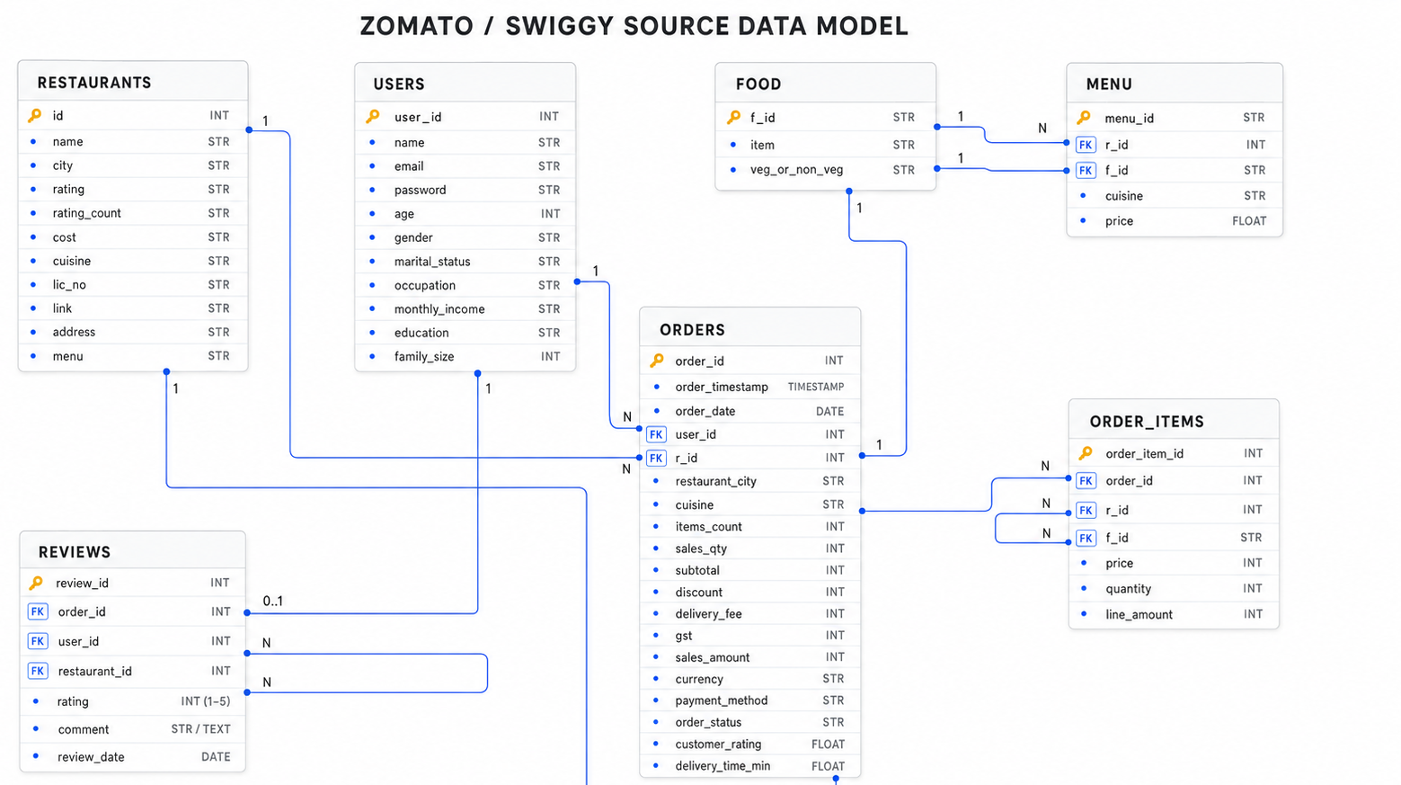

Slide 10
The volume — why this needs a warehouse
10M
23M
300K
orders — the core fact table
order line items
free-text reviews (the AI fuel)

Slide 11
Load Data To S3

Slide 12

Amazon S3 — Core Concepts
Object storage with 99.999999999% (11 9s) durability
Store unlimited data — objects up to 5 TB each
Buckets are region-specific, names are globally unique
Key-value store: key = object name, value = data + metadata
Versioning
Encryption
Keep multiple variants of objects
SSE-S3, SSE-KMS, SSE-C
Lifecycle
Replication
Auto-transition between storage classes
Cross-region or same-region replication
S3 Storage Classes
Standard
IA
One Zone-IA
Glacier Instant
Glacier Deep
Intelligent
Frequently accessed
Infrequent access
Single AZ, lower cost
Archive, ms retrieval
Lowest cost archive
Auto-tiering
AWS Masterclass
10

Slide 13



S3 mechanics: buckets & prefixes
Bucket = top-level container
Globally unique name, lives in one region. Ours holds the whole lake.
the lake layout
zomato-data/
raw/
orders/
orders_0001.csv
orders_0002.csv
reviews/
reviews_0001.csv
$ aws s3 sync ./out \
s3://zomato-data/raw
Prefixes look like folders
S3 is actually flat — “raw/orders/” is just part of the key — but tools display it as folders. Organize by dataset.
Uploading
Console drag-and-drop for a few files; aws s3 cp / sync from the CLI for millions of rows.

Slide 14
ETL vs ELT — where does the T happen?
ETL · the old way
ELT · what we build
Extract → Transform → Load
Extract → Load → Transform
Transform on a separate server before loading
Warehouse compute was scarce & expensive
Rigid: changing logic means re-extracting
Load raw first; transform inside the warehouse
Cloud compute is elastic and cheap
Keep raw forever — re-transform anytime
In this project: COPY INTO lands raw CSVs in Snowflake; dbt does every transformation in the warehouse.

Slide 15


Batch vs streaming
Batch — what we build
Streaming — the future project
Process data in scheduled chunks (hourly, daily). Simpler, cheaper, and what most analytics actually needs. Airflow triggers each run.
Process events continuously, seconds after they happen. Kafka + Spark + Iceberg territory — a sequel project once batch fundamentals are solid.

Slide 16



The Medallion Architecture
Each layer is rebuildable from the one before it — raw data is never thrown away.
RAW (Bronze)
→
STAGING (Silver)
→
MARTS (Gold)
Data exactly as it landed from the lake. Untouched, append-only. Schema: RAW
Cleaned, typed, renamed. One staging model per source table. Schema: STAGING
Business-ready dimensions, facts and aggregates. What BI and AI consume. Schema: MARTS
Why layers? Debuggability (trace any number back to raw) and safety (bad transform ≠ lost data).

Slide 17
2
The Cloud Data Warehouse (Snowflake)

Slide 18



IAM in five minutes
Users & access keys
An IAM user is a programmatic identity; its access key + secret let scripts and Snowflake talk to AWS as that user.
Least privilege
Grant only what's needed: read access to this one bucket — not AdministratorAccess. Small blast radius when keys leak.
Two rules that save careers
Never use root account keys. Never commit keys to Git — environment variables only (a theme we'll repeat).

Slide 19
Load Data To Snowflake

Slide 20


RBAC — why dbt doesn't run as admin
Privileges → roles → users
Grant USAGE / SELECT / CREATE to a role; grant the role to a user. Change the role once, every user of it follows.
A dedicated DBT_ROLE
dbt connects as a service user with DBT_ROLE: full rights on the ZOMATO database, nothing else. Automation never runs as ACCOUNTADMIN.
Why bother in a course project?
Because it's free to do right, and least-privilege muscle memory is exactly what employers expect from a data engineer.

Slide 21



What a cloud data warehouse is
Built for analytics
Columnar storage and massive parallel scans: aggregate 10M rows in seconds. The opposite trade-off from an app database.
Storage and compute are separate
Snowflake's core idea: data is stored once; independent compute clusters (“warehouses”) spin up, query it, and shut down.
Pay per second of compute
An X-Small warehouse with auto-suspend costs almost nothing when idle. Scale up for a big load, back down after.

Slide 22



Loading data: stage → file format → COPY
→
→
Stage
File format
COPY INTO
Named pointer to the S3 location
How to parse: CSV, delimiter, header
Parallel bulk load into a raw table
CREATE STAGE zomato_stage STORAGE_INTEGRATION = s3_int URL = 's3://zomato-data/raw/'
CREATE FILE FORMAT csv_fmt TYPE='CSV' SKIP_HEADER=1 FIELD_OPTIONALLY_ENCLOSED_BY='"'
COPY INTO raw.orders
FROM @zomato_stage/orders/ FILE_FORMAT = (FORMAT_NAME='csv_fmt');

Slide 23



Loading messy files without losing data
SKIP_HEADER = 1
ON_ERROR
The first line is column names, not data. Forget it and your table gains a row of strings.
ABORT_STATEMENT = strict (fail the load). CONTINUE = tolerant (skip bad rows, keep going). Know which you're choosing.
Column-count mismatch
The philosophy
Ragged rows kill loads. ERROR_ON_COLUMN_COUNT_MISMATCH=FALSE lets them land for later inspection.
Land data tolerantly in RAW as text; enforce types and quality downstream in dbt, where failures are visible and testable.

Slide 24
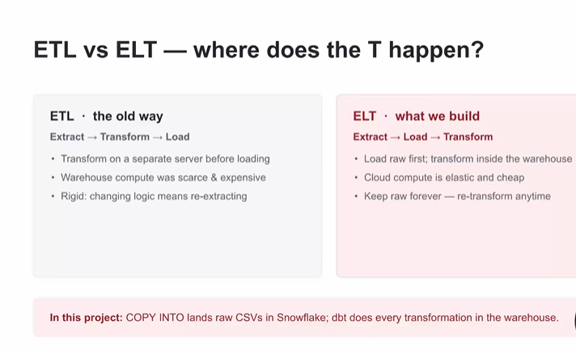
we do here ELT

Slide 26
3
Transformation with dbt

Slide 27



What dbt is — and why everyone uses it
SQL SELECTs become managed tables
You write a SELECT; dbt wraps it in the right CREATE statement, runs it in Snowflake in dependency order, and tracks what depends on what.
Software practices for analytics
Version control, code review, automated tests, generated docs — applied to SQL. This job title is “analytics engineering.”
dbt stores nothing
It's a compiler + orchestrator for SQL. All data and all compute stay in Snowflake — dbt just tells it what to build, in what order.

Slide 28


Project setup
dbt init
Scaffolds the project: models/, snapshots/, tests/, dbt_project.yml.
dbt_project.yml
name: 'zomato'
profile: 'zomato'
models:
zomato:
staging:
+materialized: view
Two config files
dbt_project.yml = the project (name, folders, defaults). profiles.yml = the connection (account, user, role DBT_ROLE, warehouse).
dbt debug
One command that validates config + connection before you build anything. Run it first, always.
Gotcha: the key under models: must exactly match name: — mismatch means your folder configs silently don't apply.

Slide 29


Sources — declaring where raw data lives
_sources.yml names the raw tables
Declare ZOMATO.RAW's tables once; models refer to them as source('zomato', 'orders').
models/staging/_sources.yml
sources:
- name: zomato
database: ZOMATO
schema: RAW
tables:
- name: orders
- name: reviews
- name: users
Why not hardcode names?
Sources make lineage start at raw, survive renames in one place, and enable source freshness checks later.

Slide 30


A model is just a SELECT
One .sql file = one model = one table/view
No CREATE TABLE boilerplate — dbt adds it. The file name becomes the object name in Snowflake.
models/staging/stg_orders.sql
select
order_id,
user_id,
order_status,
total_amount
from {{ source(
'zomato','orders'
) }}
dbt run
Compiles the Jinja, figures out order, executes in Snowflake. Rerun anytime; it rebuilds cleanly.
dbt run --select staging

Slide 31

ref() builds the DAG for you
Depend on models with ref()
select … from {{ ref('stg_orders') }} — never a hardcoded table name between models.
raw.orders
↓
stg_orders
dbt infers the run order
From source() and ref() calls, dbt assembles the dependency graph (DAG) and runs upstream models first — parallelizing where it can.
↓
fct_orders
↓
mart_daily_gmv

Slide 32



Materializations — how a model becomes real
Set per folder in dbt_project.yml or per model with {{ config(materialized='…') }} — our first taste of Jinja.
view (default)
table
incremental
Stores only the query. Always fresh, zero storage — but recomputed on every read. Fine for staging.
Physically built each dbt run. Fast to query; costs a full rebuild. Good for marts.
Only processes new rows and merges them in. The answer for 10M-row facts — full slide coming up.
Rule of thumb: view until it's slow, table until it's big, incremental when rebuilds hurt.

Slide 33
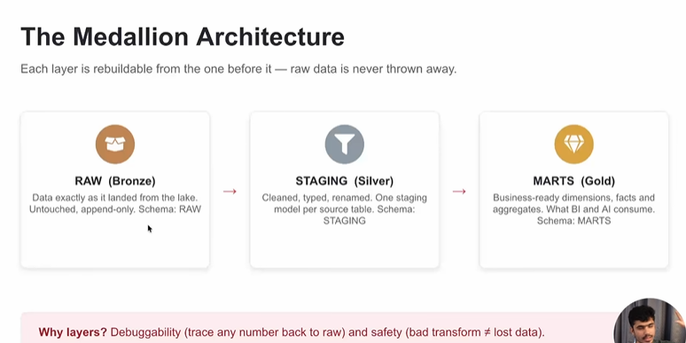

Slide 34

The Silver layer: cleaning in SQL
RAW is all text — Silver makes types
Cast safely with try_to_number / try_to_decimal: garbage becomes NULL instead of a crashed query.
stg_orders.sql (excerpt)
try_to_decimal(total_amount,10,2)
as total_amount,
lower(nullif(status,''))
as order_status,
initcap(trim(city))
as city,
regexp_substr(phone,
'[0-9]+') as phone_digits
Standardize strings
nullif('','') for fake empties, initcap/lower for casing, regexp_substr to dig values out of messy text, coalesce for defaults.

Slide 35



Dimensional modeling — the star schema
Facts: events + measures
fct_orders — one row per order, with amounts and timestamps.
dim_users
dim_restaurants
Dimensions: the context
Who, where, what, when. Derived attributes via CASE (spend bands, delivery-time buckets).
fct_orders
Why a star?
Predictable joins, fast aggregates, and BI tools understand it instantly.
dim_menu_items
dim_date

Slide 36


The date spine — a calendar built from nothing
The problem: missing days vanish
GROUP BY order_date skips days with zero orders — charts silently lie. You need one row per calendar day, orders or not.
dim_date.sql
select
dateadd('day',
seq4(),
'2023-01-01'
)::date as date_day
from table(
generator(
rowcount => 1096))
generator + seq4()
Snowflake can fabricate rows from thin air. Generate N sequential numbers, add each to a start date — instant calendar dimension.

Slide 37

Incremental models — stop rebuilding 10M rows
Process only what's new
First run builds the full table. Every run after: select rows newer than what {{ this }} already has, and MERGE them in via unique_key.
fct_orders.sql
{{ config(
materialized='incremental',
unique_key='order_id') }}
select ... from {{ ref(
'stg_orders') }}
{% if is_incremental() %}
where ordered_at > (
select max(ordered_at)
from {{ this }})
{% endif %}
Escape hatch
Logic changed? dbt run --full-refresh rebuilds from scratch. Incremental is an optimization, never a trap.

Slide 38



The Gold layer: marts & aggregations
Revenue marts
Delivery performance
Daily GMV & AOV per city/cuisine. Snowflake helpers: count_if, iff, div0 (no divide-by-zero crashes).
datediff for durations; median & percentile_cont for honest SLAs — averages hide the pain.
Cancellations
Cohorts & retention
Cancel rate by city, hour, restaurant — count_if(status='cancelled') / count(*), safely with div0.
Group users by signup month, track who reorders. Stacked CTEs keep the logic readable.

Slide 39
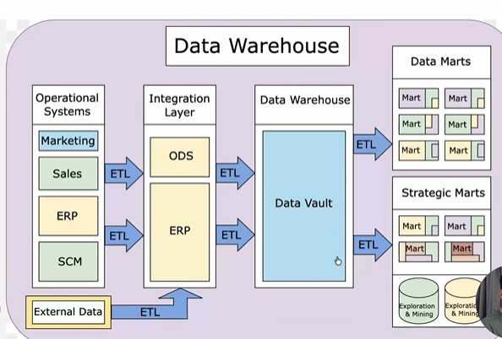

Slide 40
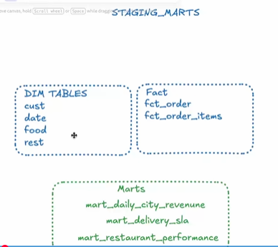

Slide 41
Data quality — tests that run in the warehouse
Generic tests — one YAML line each
Singular tests — custom SQL
unique — no duplicate order_ids
not_null — keys always present
relationships — every FK exists in its dim
accepted_values — status ∈ known set
Any business rule you can write as a query that must return zero rows:
“No order may have a delivered_at earlier than ordered_at.”
“GMV per day must never be negative.”
dbt test runs them all against real warehouse data — a quality gate on every pipeline run.

Slide 42


dbt build & the free documentation site
dbt test --> to run the _filename.yml test in each models
dbt build = run + test + snapshot
One command, DAG order, fail fast: if a staging test fails, downstream marts never build on bad data.
dbt docs generate && dbt docs serve
A searchable website of every model, column and test — generated from code you already wrote.
The lineage graph
The DAG rendered visually: click any model, see everything upstream and downstream. The single best explain-your-pipeline tool you'll own.

Slide 43
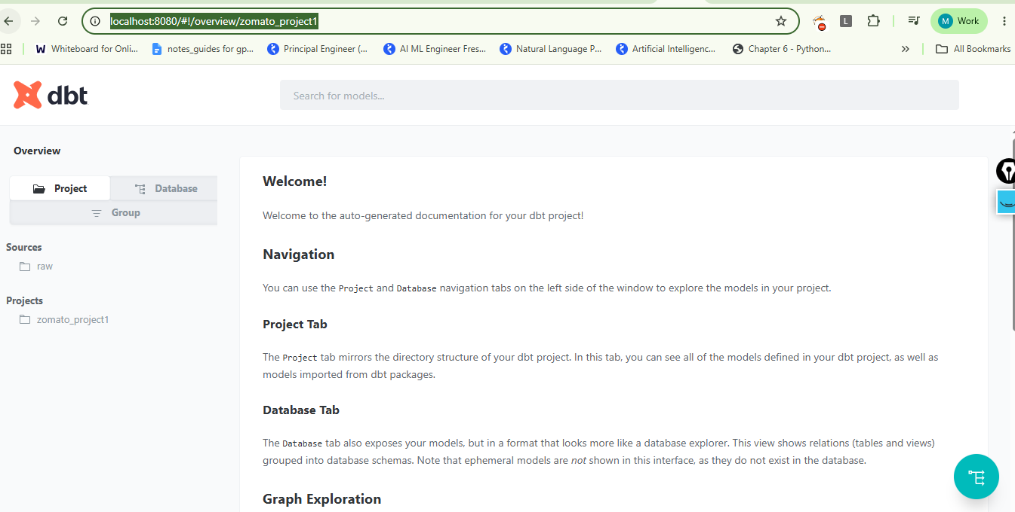
build the project from start to end
http://localhost:8080/#!/overview/zomato_project1
run --> dbt build
dbt create the documentations for dbt
cmd --> dbt docs generate && dbt docs serve

Slide 44



Tags & selection — running slices of the DAG
Tag models by concern
AI-dependent models get tags: ['ai'] in their config; core models stay untagged.
Select what to run
dbt build --select tag:ai (just the AI slice) · --exclude tag:ai (everything else) · stg_orders+ (a model and all its children).
Why this matters soon
Airflow will run core and AI as separate tasks — dbt_build_core excludes the AI tag, dbt_build_ai selects it. Selection makes that split possible.

Slide 45
4
Orchestration with Airflow

Slide 46
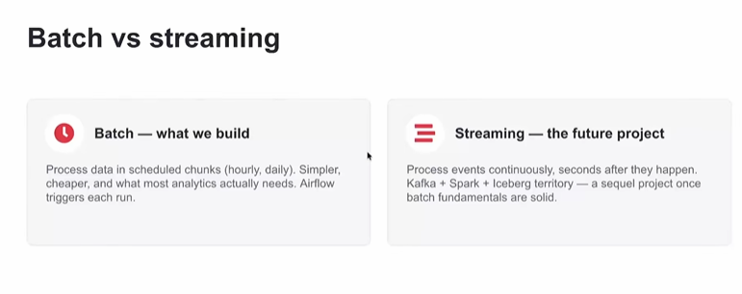

Slide 47


Why cron isn't enough
Scheduling with dependencies
“Run dbt only after the load succeeds” — cron can't express order; an orchestrator's whole job is the arrows between steps.
Retries & alerting
Networks blip, APIs time out. Airflow retries with backoff and tells you when something is truly broken.
History & observability
Every run, every task, every log, forever. “Did Tuesday's load run? Why is the mart stale?” — answered in one UI.

Slide 48


Airflow in four concepts
DAG
Task
The whole workflow: tasks + dependencies, defined in a Python file, with a schedule.
One unit of work — load this table, run dbt, call the enrichment script.
Operator
Scheduler
The task template: SQLExecuteQueryOperator, BashOperator, PythonOperator. You configure, it executes.
The engine that watches the clock, resolves t1 >> t2 dependencies, and fires tasks. The web UI shows it all.

Slide 49
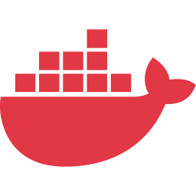
Running Airflow locally with Docker
docker compose up
Airflow is several services (scheduler, webserver, metadata DB). One compose file starts them all, wired together, on your laptop.
A custom Dockerfile
We extend the official image to add our dependencies — the standard pattern for real deployments too.
Volumes mount your code
The local dags/ folder is mounted into the containers: edit a DAG file, refresh the UI, it's live. No rebuild loop.

Slide 50

Connections & the two operators we use
Connections: creds by ID
Snowflake account, user, role stored once in Airflow as snowflake_default. DAG code references the ID — no secrets in Python files.
SQLExecuteQueryOperator
Runs SQL against Snowflake through the connection — our COPY INTO reload lives here.
BashOperator
Runs shell commands — how Airflow invokes dbt build (and the enrichment script's CLI).

Slide 51

Keeping dbt out of Airflow's dependencies
The conflict
Airflow and dbt disagree on shared Python libraries. Install both in one environment and pip's resolver eventually loses.
Dockerfile (excerpt)
FROM apache/airflow:2.9
RUN python -m venv \
/opt/dbt_venv
RUN /opt/dbt_venv/bin/pip \
install dbt-snowflake
# BashOperator calls:
# /opt/dbt_venv/bin/dbt
The fix: a venv inside the image
The Dockerfile builds a dedicated virtualenv just for dbt. Airflow never imports dbt — it just shells out to it.

Slide 52


Our DAG — four tasks, one story
→
→
→
reload_raw
dbt_build_core
enrich_reviews
dbt_build_ai
COPY INTO refreshes RAW from S3
build + test everything except tag:ai
LLM adds sentiment + topic (new rows only)
build tag:ai marts on enriched data
Read it aloud: refresh raw → build the core warehouse → let the LLM enrich → build the AI marts. The whole project in one line.

Slide 53



Idempotency — the property that lets you sleep
Definition
Running a task twice produces the same result as once: no duplicate rows, no double-billed API calls.
How we achieve it
Incremental models MERGE on keys · enrichment processes only rows NOT already enriched · loads are deterministic.
Why it matters
Airflow will retry failures — that's the feature. Retries are only safe when every task is idempotent. Non-idempotent + auto-retry = data corruption on a schedule.

Slide 54
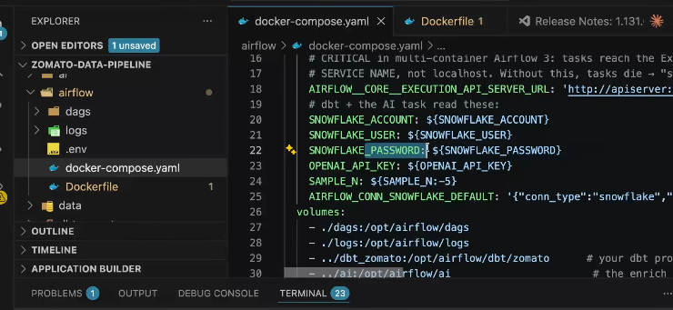
docker-compose up -d
docker-compose down
docker-compose up

Slide 55
5
The AI Layer (OpenAI)

Slide 56

Why AI belongs in a data pipeline
Classic DE handles structured data
Numbers, categories, timestamps — everything so far. But huge value hides in free text: reviews, tickets, chats.
SQL can't understand meaning
SELECT can count reviews; it cannot tell you a review is an angry complaint about late delivery. That gap is exactly what LLMs close.
The AI Data Engineer
Plugs an LLM into the pipeline as just another transformation, and builds apps on top of the warehouse. Not an ML researcher — an engineer with one new tool.

Slide 57


What we'll build — three AI capabilities
① Enrichment
② RAG
③ Text-to-SQL
The LLM reads every review and writes sentiment + topic columns back to Snowflake. Feelings become queryable.
“Chat with your reviews” — semantic search finds the relevant ones, the LLM answers only from those.
“Chat with your warehouse” — plain English in, real Snowflake SQL out, run safely, answer back.

Slide 58

Where LLMs sit in the AI universe
A model = learned patterns
Patterns learned from data that map input → output. Nobody hand-writes the rules — that's the whole point.
Artificial Intelligence
Machine Learning
Deep Learning
Each ring specializes the last
AI is the goal; ML learns from data; deep learning uses neural networks; LLMs are deep learning applied to language.
LLMs

Slide 59

An LLM predicts the next token. That's it.
Trained on massive text
A Large Language Model has read a huge slice of the internet with one training objective: given text so far, predict what comes next.
One objective, many skills
Predicting next tokens well enough forces the model to absorb grammar, facts and reasoning — so it can summarize, classify, translate and write.
“The biryani arrived cold and the rider was 40 minutes ___” → late (p=0.92)

Slide 60
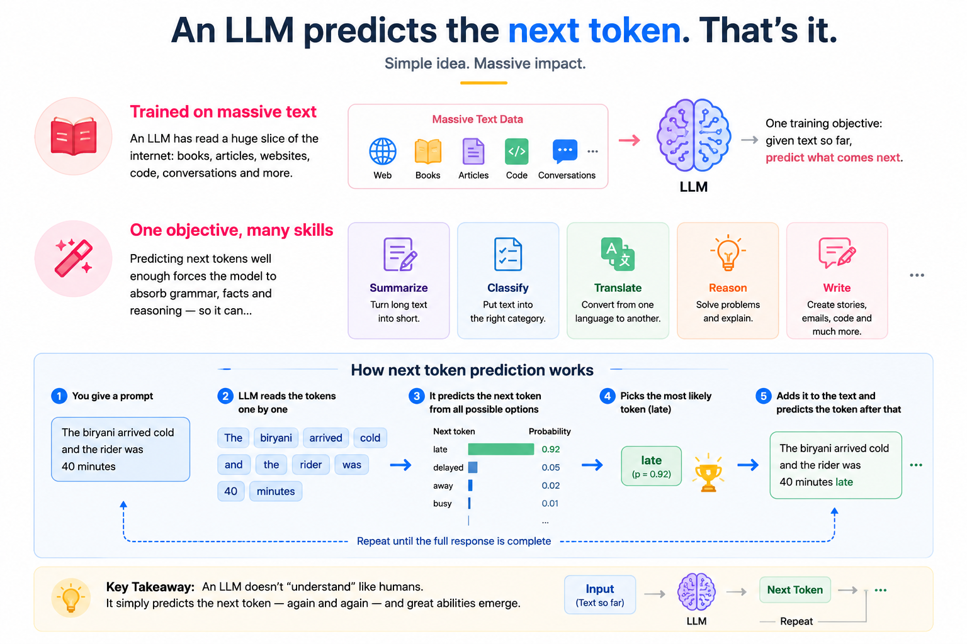

Slide 61
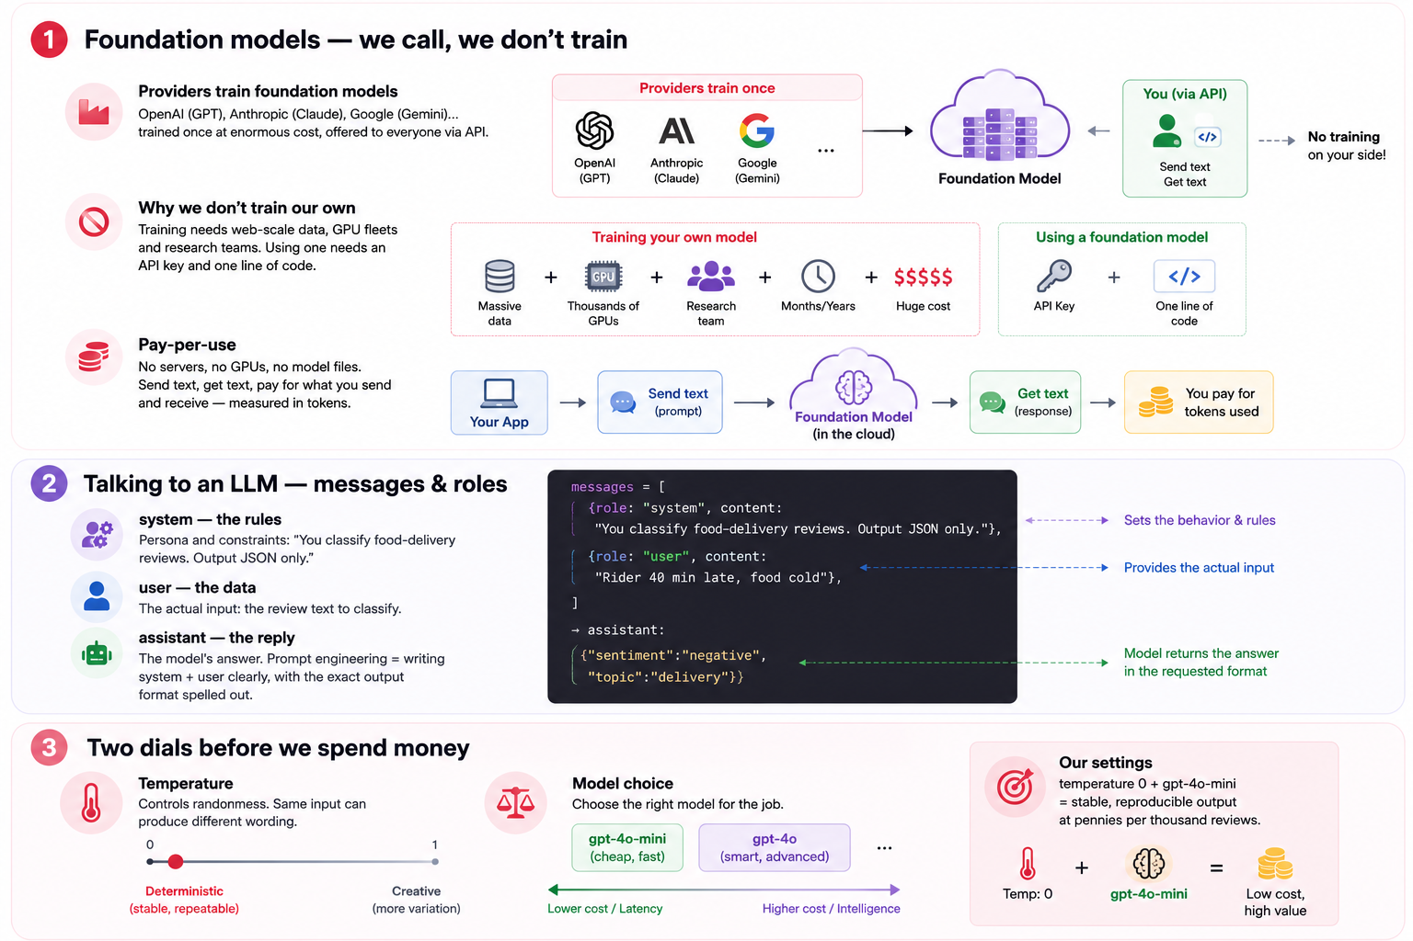

Slide 62
The money slide — read before running anything
≈ ¾
in + out
~$7-9
of a word = one token. Models read & write tokens, and you pay per token
you pay for input tokens AND output tokens, at different rates
ballpark to enrich all 300K reviews with gpt-4o-mini (~45M input tokens)
Our two defenses: SAMPLE_N caps how many reviews each run processes, and idempotency guarantees no review is ever paid for twice.

Slide 63



The context window — the model's field of view
A hard limit on what fits
The context window is the maximum tokens a model can see at once — prompt + data + its own reply, all inside one budget.
So you can't dump a table into a prompt
300K reviews are millions of tokens; no window holds that. “Just paste everything” is not a strategy.
Remember this limitation
It's exactly why RAG exists: retrieve only the few most relevant pieces and put those in the window. We'll build it in 6.7.

Slide 64


Making LLM output usable as data
Problem: LLMs reply in prose
“This customer seems quite unhappy about…” — charming, unparseable. A pipeline needs columns.
every reply, guaranteed JSON
{
"sentiment": "negative",
"topic": "delivery"
}
sentiment ∈ positive |
negative | neutral
topic ∈ delivery | food |
price | app | service
Fix: demand JSON
response_format={type:'json_object'} + a system prompt that names the exact fields. The reply parses straight into table columns — reliable, testable.

Slide 65
LLM enrichment — a normal ELT step
→
→
READ
CALL
WRITE
un-enriched reviews from Snowflake
gpt-4o-mini classifies each comment
sentiment + topic rows into AI.REVIEW_ENRICHED
SELECT city, topic, count(*) FROM mart_review_insights
WHERE sentiment = 'negative' GROUP BY 1,2 ORDER BY 3 DESC;

Slide 66
Enrichment done right: idempotent & modeled
Never pay for the same review twice
Each run selects reviews NOT IN (already enriched) LIMIT SAMPLE_N. Re-run all you like — only new rows cost money.
The LLM's output is just another table
ZOMATO.AI.REVIEW_ENRICHED is declared as a dbt source; mart_review_insights joins it with the star schema like any other data.
The “aha” of the whole module
AI folds cleanly into the medallion flow. No special AI infrastructure — a source, a model, a mart. That's the AI Data Engineer pattern.

Slide 67
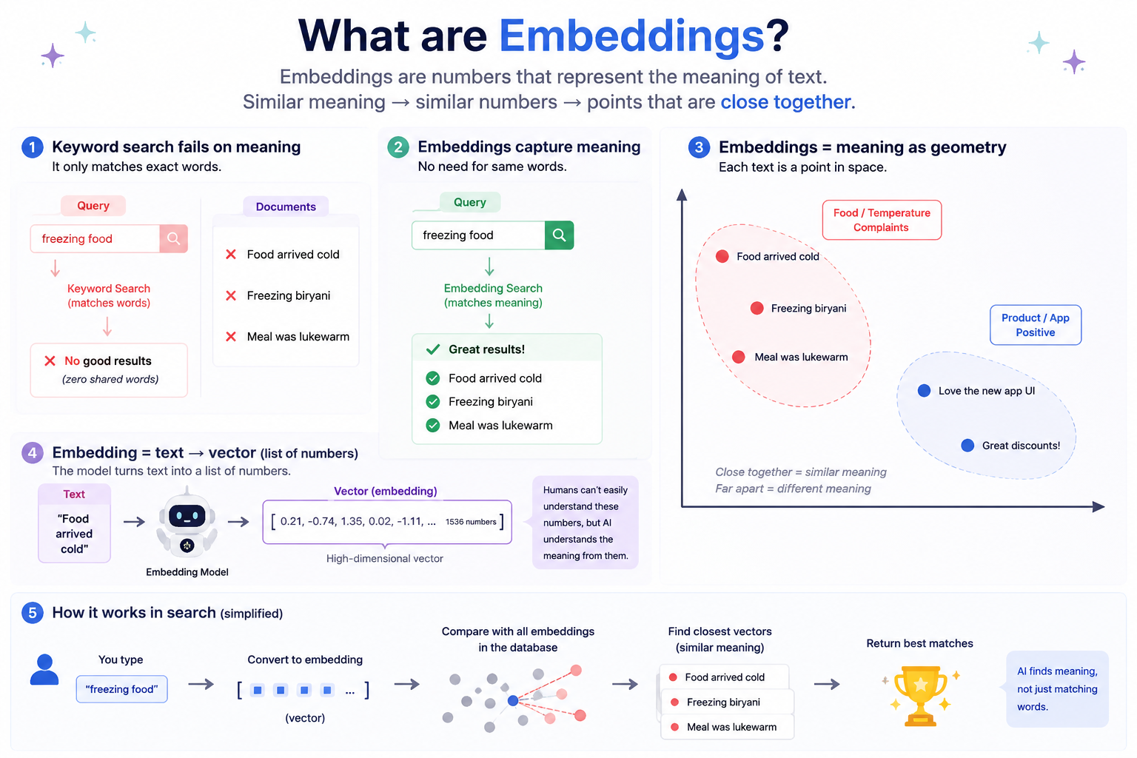

Slide 68
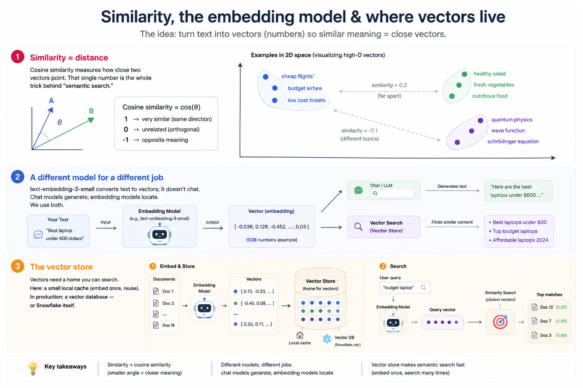

Slide 69
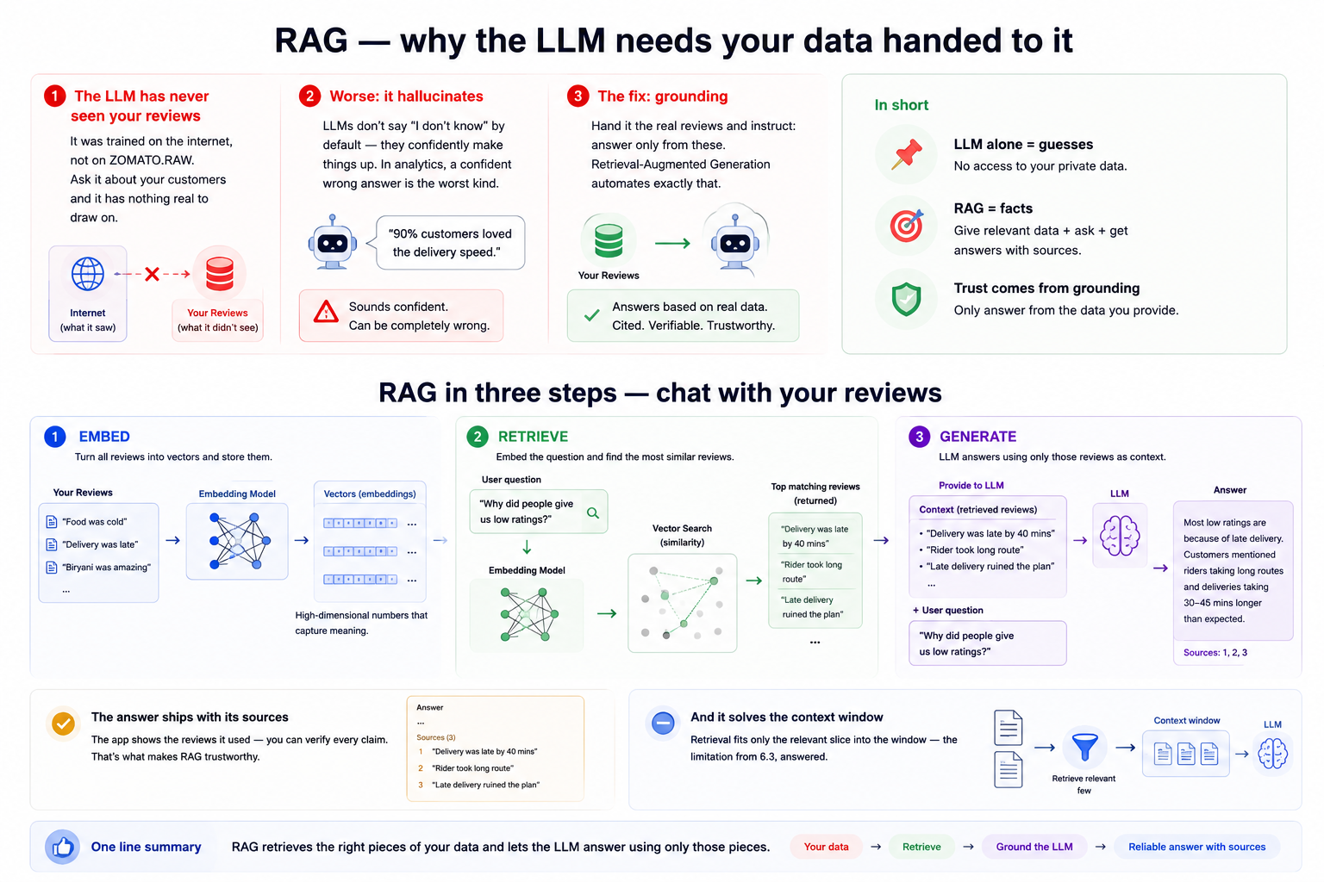

Slide 70


RAG in three steps — chat with your reviews
→
→
1 · EMBED
2 · RETRIEVE
3 · GENERATE
All reviews → vectors, once, cached
Embed the question; find the most similar reviews
LLM answers using only those reviews as context
The answer ships with its sources
The app shows the reviews it used — you can verify every claim. That's what makes RAG trustworthy.
And it solves the context window
Retrieval fits only the relevant slice into the window — the limitation from 6.3, answered.

Slide 71
Text-to-SQL — chat with your warehouse
→
→
→
English question
LLM + schema
SQL runs
Answer + SQL
“Which city cancels the most?”
prompt includes the marts' tables & columns
generated SELECT executes on Snowflake
result shown with the query for review
Schema-grounding: the model writes correct SQL because it sees your real table and column names — no invented columns. Same grounding idea as RAG, applied to metadata.
The headline demo: someone who's never written SQL asks the warehouse a question and gets a real answer.

Slide 72

Making text-to-SQL safe to run
Guardrail 1: SELECT-only validation
Before executing, verify the generated query is a read-only SELECT — reject DROP / DELETE / UPDATE / anything else. Code checks, not vibes.
Guardrail 2: a limited role
The app connects as DBT_ROLE, not admin — even a malicious query couldn't do damage. Defense in depth.
The bugs were the best teachers
Real failures we hit: 2-part vs 3-part table names, and sentiment stored lowercase while the model guessed 'Negative'. Lesson: ground the model precisely or it improvises.

Slide 73


Putting the AI layer into production shape
Enrichment is an Airflow task
RAG & text-to-SQL are apps
enrich_reviews runs between dbt_build_core and dbt_build_ai — scheduled, retried, idempotent like everything else.
Streamlit serving apps that sit on top of the warehouse — they read, they never load.
Cost control recap
Secrets
SAMPLE_N caps volume · cheap model · idempotent enrichment · embeddings cached, never recomputed.
OPENAI_API_KEY lives in an environment variable. Never in code, never in Git — same rule as the AWS keys.

Slide 74
The AI vocabulary — one slide
LLM
model that predicts next tokens
prompt
your instruction (system + user)
token
≈ ¾ word; the unit you pay for
context window
max tokens seen at once
temperature
randomness dial; low = stable
structured output
force JSON, get columns
embedding
text → vector of meaning
vector
list of numbers = a location
cosine similarity
closeness of two vectors
vector store
searchable home for vectors
RAG
retrieve, then generate grounded
grounding
answer only from given data
hallucination
confident made-up output
schema-grounding
show real tables → real SQL
idempotency
re-runs never double-pay

Slide 75
6
Serving & Dashboards

Slide 76
The questions the Gold layer answers in one SELECT
GMV & AOV
Cancel rate
Delivery SLA
Gross merchandise value and average order value — by day, city, cuisine.
Where and when orders die — by city, hour and restaurant.
Median and p90 delivery time — honest numbers, not averages.
Cohorts & retention
Sentiment × topic
Restaurant quality
Which signup months keep ordering — the growth team's favorite chart.
The AI mart: what customers complain about, per city — now in SQL.
Ratings, review volume and revenue joined in one view.

Slide 77
Streamlit — dashboards in pure Python
A dashboard in an afternoon
Streamlit turns a Python script into a web app: st.metric for KPIs, st.line_chart for trends — all reading the Gold marts directly.
Thin serving, thick warehouse
All heavy lifting stayed in dbt models; the dashboard just SELECTs from marts. Serving layers should be boring.
The AI apps are serving too
RAG chat and text-to-SQL run as Streamlit apps beside the dashboard — three doors into the same warehouse.

Slide 78
8
MODULE 8
Wrap-up & Production Concepts
Cost management & teardown
Secrets hygiene
GitHub & your portfolio
What's next: the streaming version

Slide 79


Cost management & teardown
Auto-suspend everything
Tear down when done
Snowflake warehouses suspend after 60s idle — the single biggest cost saver in the project.
Drop unused databases and stages, empty the S3 bucket or add lifecycle rules.
Stop the containers
Watch the meters
docker compose down when not developing — Airflow idling all week eats laptop and battery for nothing.
AWS billing alerts + OpenAI usage dashboard. Surprises are a choice; alerts are free.

Slide 80

Secrets hygiene & the portfolio payoff
Environment variables, always
AWS keys, Snowflake password, OPENAI_API_KEY — all read from env vars or .env files that are in .gitignore. One leaked key can cost real money within hours.
Put it on GitHub
Clean repo, clear README with the architecture diagram, setup steps that actually work. This project is portfolio gold — it shows breadth few juniors have.
Talk about it like an engineer
“I built an ELT pipeline with an LLM enrichment stage, tested with dbt, orchestrated with Airflow” — every word of that is interview currency.

